Slide 1
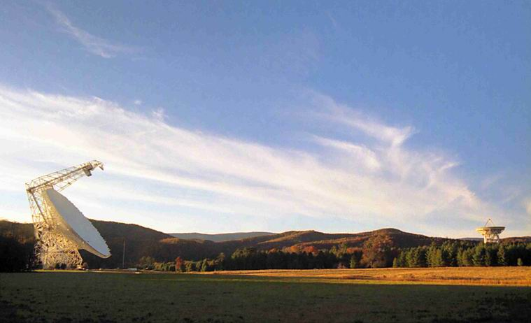
Observing Techniques with Single-Dish Radio Telescopes
Dr. Ron Maddalena
National Radio Astronomy Observatory
Green Bank, WV

Slide 2
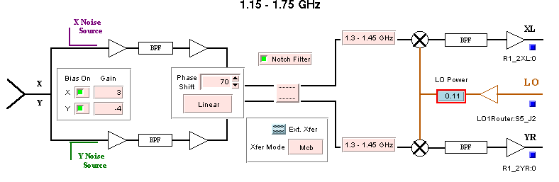
Typical Receiver

Slide 3
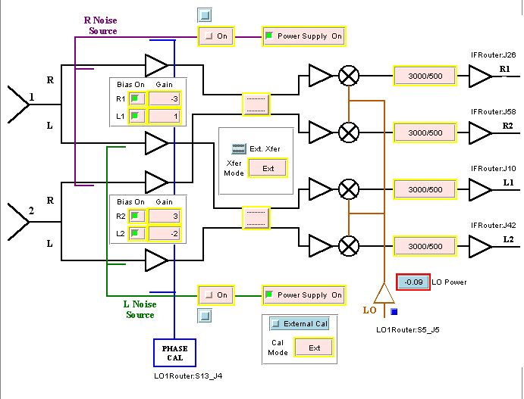
Dual Feed Receiver

Slide 4
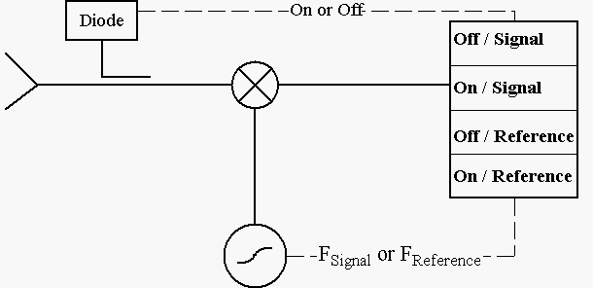
Model Receiver

Slide 5
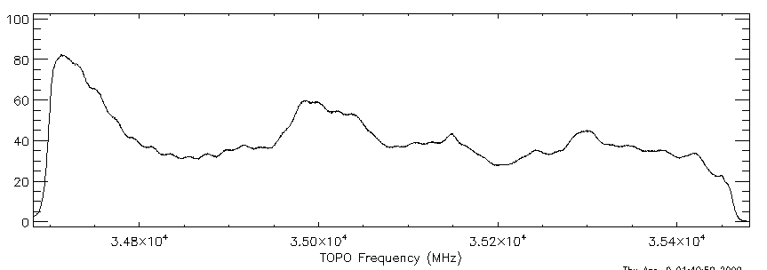
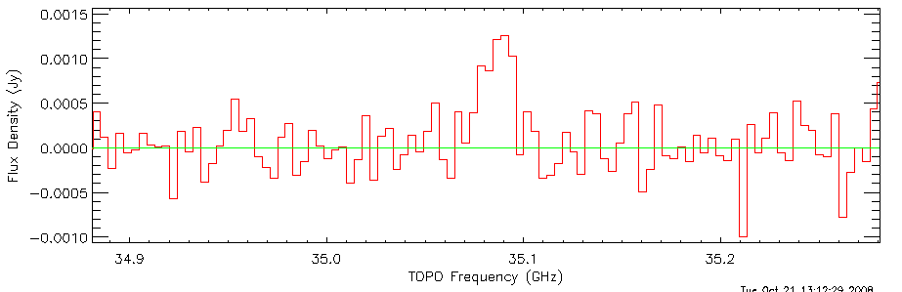
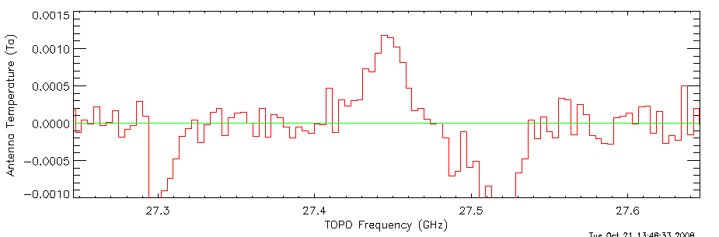
Spectral-line observations
Raw Data
Reduced
Data – High
Quality
Reduced
Data –
Problematic

Slide 6
Reference observations
Difference a signal observation with a reference observation
Types of reference observations
  Frequency Switching
    In or Out-of-band
  Position Switching
  Beam Switching
    Move Subreflector
    Receiver beam-switch
  Dual-Beam Nodding
    Move telescope
    Move Subreflector

Slide 7
Frequency switching
Eliminates bandpass shape from components after the mixer
Leaves the derivative of the bandpass shape from components before the mixer.

Slide 8
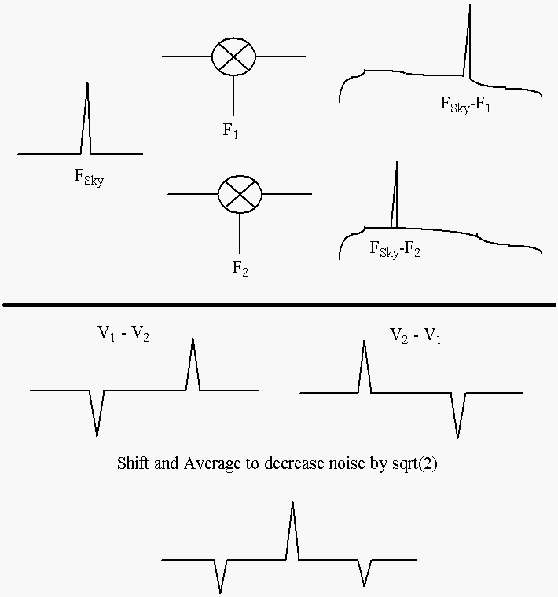
In-Band Frequency Switching

Slide 9
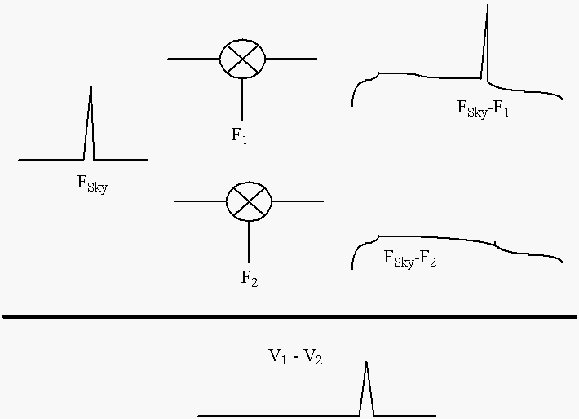
Out-Of-Band Frequency Switching

Slide 10
Position switching
Move the telescope between a signal and reference position
  Overhead
  ½ time spent off source
Difference the two spectra
Assumes shape of gain/bandpass doesn’t change between the two observations.
For strong sources, must contend with dynamic range and linearity restrictions.

Slide 11
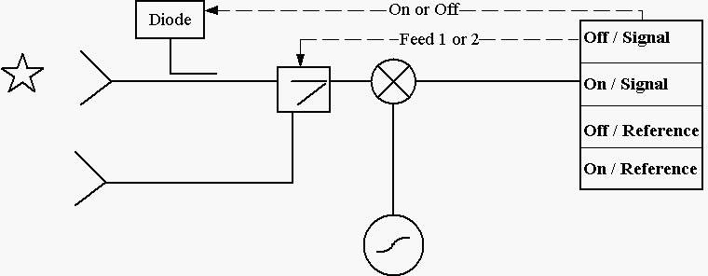
Beam switching – Internal switch
Difference spectra eliminates any contributions to the bandpass from after the switch
Residual will be the difference in bandpass shapes from all hardware in front of the switch.
Low overhead but ½ time spent off source

Slide 12
The Atmosphere
Opacity
  Tsys = Trcvr + Tspill +
  Tcmb * exp(-Tau*AirMass) +
  Tatm * [exp(-Tau*AirMass) – 1]
  Air Mass ~ 1/sin(Elev) for Elev > 15°
Stability
  Tsys varies quickly with time
  Worse when Tau is high
Helps that the atmosphere is in the near field

Slide 13
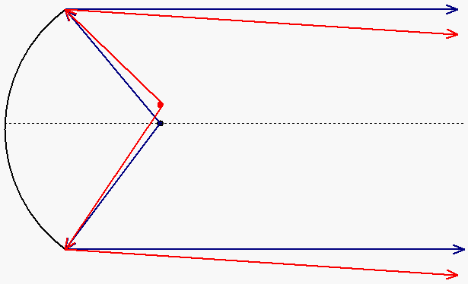
Atmosphere is in the near field
Common to all feeds in a multi-feed receiver

Slide 14
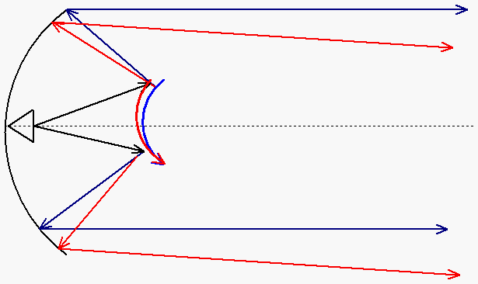
Atmosphere is in the near field
Common to data taken in both positions of the subreflector

Slide 15
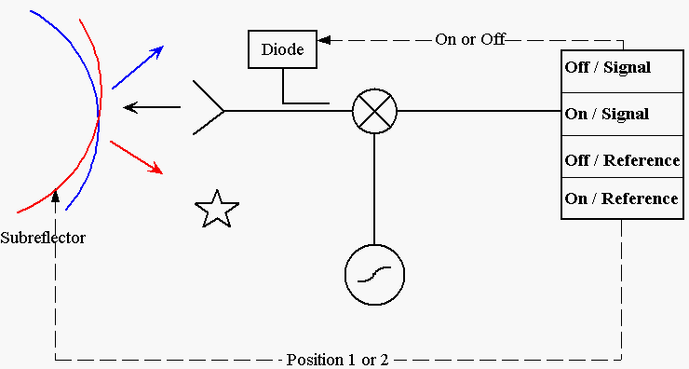
Beam Switching – Subreflector or tertiary mirror
Optical aberrations
Difference in spillover/ground pickup
Removes any ‘fast’ gain/bandpass changes
Low overhead. ½ time spent off source

Slide 16
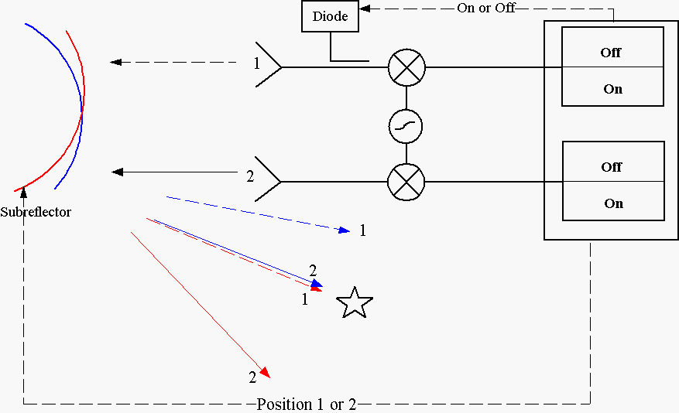
Nodding with dual-beam receivers - Subreflector or tertiary mirror
Optical aberrations
Difference in spillover/ground pickup
Removes any ‘fast’ gain/bandpass changes
Low overhead. All the time is spent on source

Slide 17
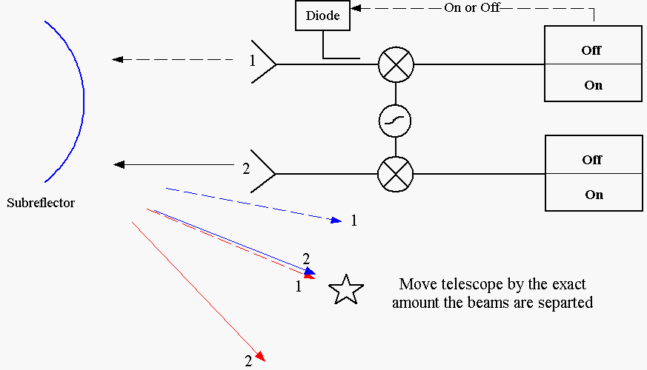
Nodding with dual-beam receivers - Telescope motion
Optical aberrations
Difference in spillover/ground pickup
Removes any ‘fast’ gain/bandpass changes
Overhead from moving the telescope. All the time is spent on source

Slide 18
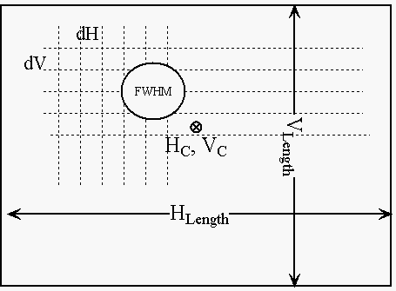
Mapping with a single pixel
Map has a center
Width x Height
Spacing
  Nyquist sampling =
  λ / 2D radians or less
  Typically 0.9 λ / 2D radians
  Loosely related to FWHM beamwidth (~1.2 λ / D radians)

Slide 19
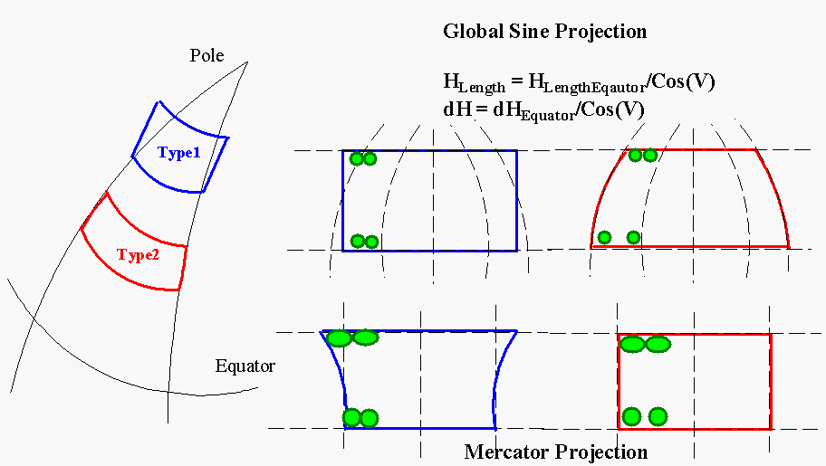
Projection effects

Slide 20
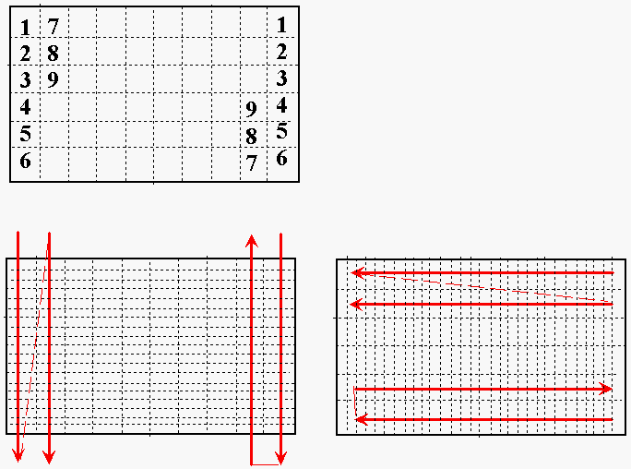
Types of maps
Point map
  Sit, Move, Sit, Move, etc.
On-The-Fly Mapping
  Mangum, Emerson, Greisen 2008, Astro& Astroph.
  Slew a column or row while collecting data
  Move to next column row
  Basket weave
  Should oversanple ~3x Nyquist along direction of slew

Slide 21
Other mapping issues
Non-Rectangular regions
Sampling “Hysteresis”
Reference observations
  Use edge pixels @ no costs
  Interrupt the map
  Built-in (frequency/beam switching, nodding, etc.)
Basketweaving

Slide 22
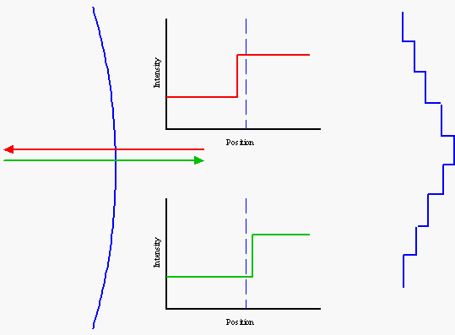
“Hysteresis”
From inaccurate time tags for either telescope positions or data samples

Slide 23
Other mapping issues
Non-Rectangular regions
Sampling “Hysteresis”
Reference observations
  Use edge pixels @ no costs
  Interrupt the map
  Built-in (frequency/beam switching, nodding, etc.)
Basketweaving

Slide 24
Basketweaving
S (θ,φ) = [I_{Source}(θ,φ) + I_{Atmosphere} (θ,φ) ]⊗ P_{ant}(θ,φ)
I_{Source} is correlated between the 2 maps
I_{Atmosphere} is not correlated

Slide 25
Mapping with multi-pixel receivers
Useful when object larger than beam separation
Uniform sampling difficult
Redundant sampling
  S (θ,φ) = [I_{Source}(θ,φ) + I_{Rcvr} (θ,φ) ]⊗ P_{ant}(θ,φ)
  I_{Source} is correlated between the 2 maps
  I_{Rcvr} is not correlated
Field rotation

Slide 26
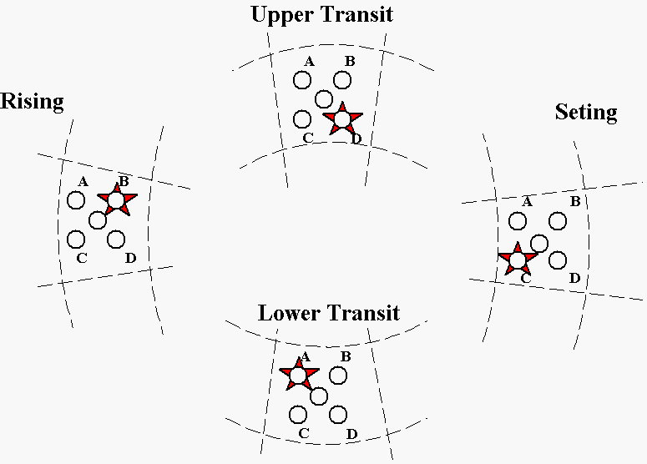
Field Rotation

Slide 27
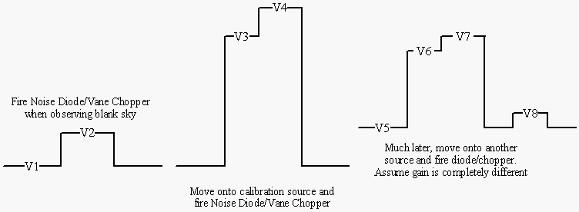
Astronomical Calibration
Determine T_{cal} from calibrator:
  A = (V2-V1) + (V4-V3)
  B = (V4-V2) + (V3–V1)
  T_{cal} = (A/B) ∙ (η A_{p} S_{src} /2k) ∙ exp(-Tau*AirMass)

Slide 28
Astronomical Calibration
Determine strength of unknown source
  A = (V8-V5) + (V7-V6)
  B = (V7-V8) + (V6–V5)
  T_{A}= (B/A) ∙ T_{cal}
  S = 2kT_{A}/[η Ap exp(-Tau*AirMass)]

Slide 29
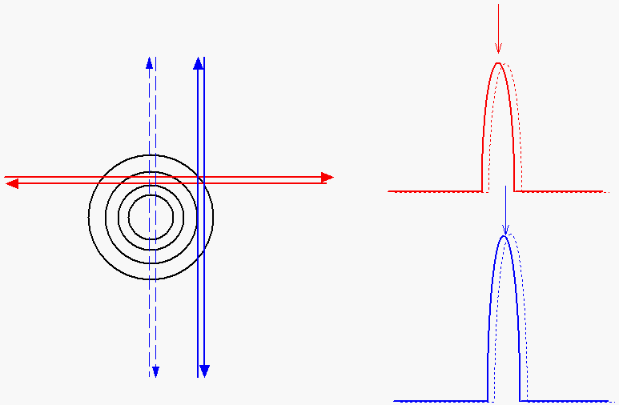
Calibration in Actual Practice

Slide 30
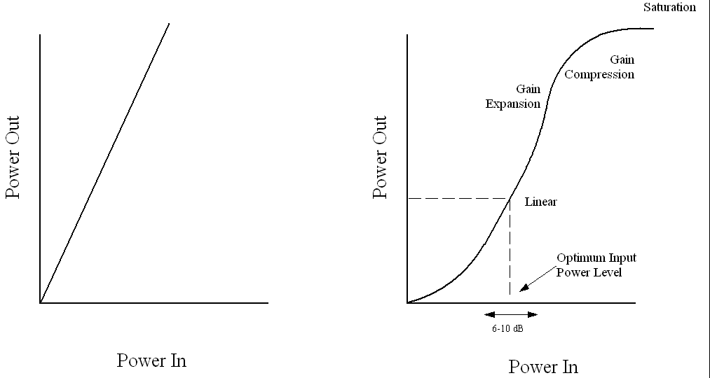
Power Balancing/Leveling and Non-Linearity
If linear, then (V2-V1) – (V4-V3) should equal zero, to within the noise

Slide 31
Sensitivity
Radiometer equation: σ = T_{sys} / Sqrt(BW ∙ t)
  But, we’re always differencing observations.\
  Hardware realities
σ = K₁ T_{sys} / Sqrt(K₂ BW ∙ t_{effective} ∙ N_{pol} ∙ N_{avrg})
  K₁: Reflects backend sensitivity (e.g., 1.23 for a 3-level correlator)
  K₂: Independence of samples (e.g 1.2 for correlator)
t_{effective} = t_{sig} t_{ref} / (t_{sig} + t_{ref})
N_{pol} = 1 or 2 (hardware dependent, assume unpolarized source)
N_{avrg} = Number of independent data streams averaged together.
  Position switching: 1
  In-Band frequency switching: 2
  Etc.

Slide 32
Stray radiation

